Slide 1


SMART CONTROL OF TRAFFIC LIGHTS USING IOT Bachelor of Technology In Electronics And Communication Engineering TEAM MEMBERS:- M.RAKESH U19EC290 M.DURGA SAI U19EC285 K.SAI MANOJ U19EC252 K.LEELA MANIKANTA U19EC257 Guide by (PROFESSOR and HOD{ ECE}): DR.H.UMMA HABIBA

Slide 2
Abstract:
Traffic light control systems are widely used to monitor and control the flow of automobiles through the junction of many roads. They aim to realize smooth motion of cars in the transportation routes. However, the synchronization of multiple traffic light systems at adjacent intersections is a complicated problem given the various parameters involved. Conventional systems do not handle variable flows approaching the junctions. In addition, the mutual interference between adjacent traffic light systems, the disparity of cars flow with time, the accidents, the passage of emergency vehicles, and the pedestrian crossing are not implemented in the existing traffic system. This leads to traffic jam and congestion. We propose a system based on NodeMCU micro controller that evaluates the traffic density using IR sensors and accomplishes dynamic timing slots with different levels. Moreover, a portable controller device is designed to solve the problem of emergency vehicles stuck in the overcrowded roads.

Slide 3
Introduction:
The road traffic conditions are becoming more and more chaotic. Many countries are actively developing intelligent transportation systems (ITS) which can lead to the improvement in the safety and efficiency of today’s transportation network .
A mobile or remote-based traffic control system plays a pivotal role in ensuring that there is no traffic congestion in a case of emergency or when there is convoy cars leading to a funeral or wedding.
By using this type of a system, many lives can be saved by being taken to the hospital as soon as possible and also unnecessary traffic jams can be avoided in traffic junctions by making use of this kind of a system.

Slide 4
Literature Survey:
Smart Traffic Light Scheduling in Smart City Using Image and Video Processing
In the proposed models, traffic light scheduling is determined based on the density and the number of passing vehicles. Moreover, it is implemented by Raspberry-Pi board and OpenCV tool. The analytical and experimental results indicate the efficiency provided by the proposed models in intelligent traffic management. Today, we face the challenge of inequality in the growth of road infrastructure compared to the growing number of vehicles in modern life [1]. Therefore, a growing volume of traffic is observed that is becoming more and more serious.

Slide 5
Literature Survey:
IOT based Smart Traffic Light Control System
Traffic Congestion and traffic monitoring is one of the important problems all over the world. This work uses IOT and Adaptive Neuro Fuzzy Inference System (ANFIS) to improve traffic conditions. An ANFIS traffic light controller with inputs as waiting time and vehicle density is developed using MATLAB SIMULINK environment. A camera is used to capture the traffic scenes and this image is transferred to the cloud using Arduino UNO and ThingSpeak Platform. The image is then analyzed in the server using ANFIS controller and appropriate control signals are sent to the traffic signals.

Slide 6
Existing system:
The microcontroller-based traffic light system for road intersection control was developed to direct the movement of vehicles meeting at a road junction without any collision.
To achieve this, the microcontroller allocates time for each path when the vehicles along that path will move and the other vehicles from the other path will stop.
When the time allocated for a specific path has been exhausted, the red light will be ON meaning stop and the next line will be ON (green light) which means the vehicle in that path should start moving. When the time is about to be exhausted, the yellow light will be ON in the third path informing the vehicles in that path to be ready to move, and after some seconds the green light will be ON.
Disadvantage is traffic light timing is fixed.

Slide 7
Disadvantages:
expensive.
not practical for all roads.
perceived by some as a way of raising funds.
less or no effect beyond the camera.
are subject to vandalism.
need regular maintenance.

Slide 8
Proposed system:
The debates on mobility almost exclusively consist of functionalist analyses of how particular mobile technologies can alleviate geographical barriers for human activity .
The developed system has allowed the Android mobile device (emergency vehicle) to override the normal operation of a traffic signal. The system comprises of NodemCU microcontroller , Arduino , IR Sensor and traffic signals.
This system will be very essential for the benefit and safety of the people of the society, thereby ensuring that there is no longer a traffic congestion that is experienced currently.
By using this type of a system, many lives can be saved by being taken to the hospital as soon as possible and also unnecessary traffic jams can be avoided in traffic junctions by making use of this kind of a system.

Slide 9
Advantages:
When properly timed, traffic signals increase the traffic handling capacity of an intersection, and when installed under conditions that justify its use, it is a valuable device for improving the safety and efficiency of both pedestrian and vehicular traffic.

Slide 10
WORKING:
The main components required to accomplish the connection. The
components are NodeMCU, Arduino UNO, IR sensors, LED lights (RED,
Green and Yellow), resistors, jumpers.
This traffic light uses an Arduino UNO microcontroller to create an
automation function together with an Infrared sensor (IR sensor) to
detect the density of the traffic. Each vehicle is set to 3 seconds. All
vehicles pass through the traffic light is measured and processed
accordingly to delays. The integrated system of this density based
traffic control consists of an IR sensor for input, an Arduino UNO
microcontroller for data interpretation, a red, yellow and green LED
for traffic light lighting and an LED Dot Matrix Module for output

Slide 11
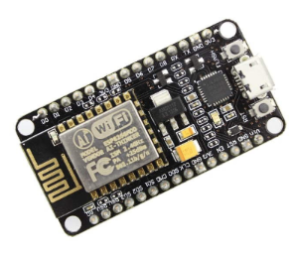
NODEMCU CONTROLLER:
If you have completed various Arduino projects and are familiar with Arduino, using NodeMCU instead of Arduino Uno is the logical next step if you’re looking for a more compact module that encompasses Wi-Fi. NodeMCU is predicated on the Esperessif ESP8266-12E Wi-Fi System-On-Chip. It is based on Lua-based firmware and is open-source.
It’s perfect for IoT projects, especially other Wireless connectivity
projects as Arduino does not work wirelessly. We either need to
connect it to a Bluetooth or nRF module This chip has a great deal in
common with the Arduino – they’re both microcontroller-equipped
prototyping boards that can be programmed using the Arduino IDE.
The ESP8266 is more updated and younger than Arduino, and
therefore the ESP has stronger specifications than Arduino.

Slide 12
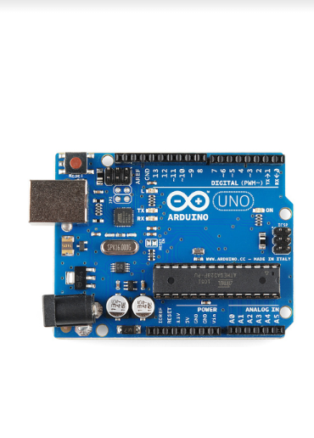
ARDUINO UNO CONTROLLER:
Arduino Uno is a microcontroller board based on the ATmega328P. It has 14 digital
input/output pins (of which 6 can be used as PWM outputs), 6 analog inputs, a 16
MHz ceramic resonator (CSTCE16M0V53-R0), a USB connection, a power jack, an
ICSP header and a reset button. It contains everything needed to support the
microcontroller; simply connect it to a computer with a USB cable or power it with
a AC-to-DC adapter or battery to get started.. You can tinker with your Uno without
worrying too much about doing something wrong, worst case scenario you can
replace the chip for a few dollars and start over again.

Slide 13
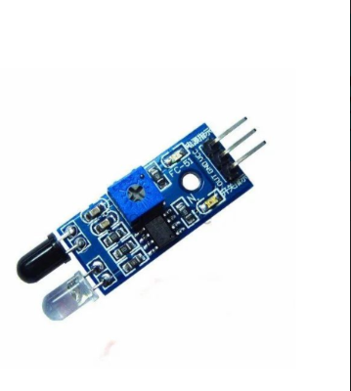
IR SENSOR:
An infrared sensor is an electronic device, that emits in order to sense some
aspects of the surroundings. An IR sensor can measure the heat of an
object as well as detects the motion. These types of sensors measure only
infrared radiation, rather than emitting it that is called a passive IR sensor.
Usually, in the infrared spectrum, all the objects radiate some form of
thermal radiation.
These types of radiations are invisible to our eyes, which can be detected
by an infrared sensor. The emitter is simply an IR LED (Light Emitting Diode)
and the detector is simply an IR photodiode that is sensitive to IR light of
the same wavelength as that emitted by the IR LED. When IR light falls on
the photodiode, the resistances and the output voltages will change in
proportion to the magnitude of the IR light received.

Slide 14
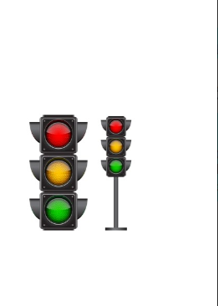
TRAFFIC LIGHT SIGNALS:
Traffic signals are given out by devices that are mostly placed at important locations such as busy intersections to regulate the flow of traffic, which includes everything from heavy commercial vehicles and cars to bicycles and pedestrians.
However, these signals come with some rules associated with them. Basically, the traffic signal rules form the very backbone of these signs and following them is vital for ensuring smooth and risk-free road travel.

Slide 15
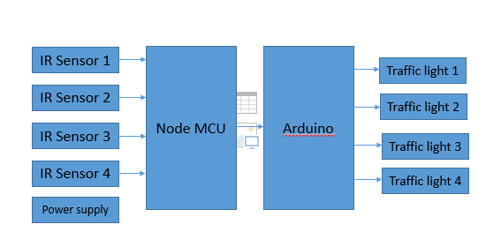
Block diagram:

Slide 16
Hardware requirements:
NodeMCU Controller
Arduino
IR sensorNode
Traffic light signals
Power Supply

Slide 17
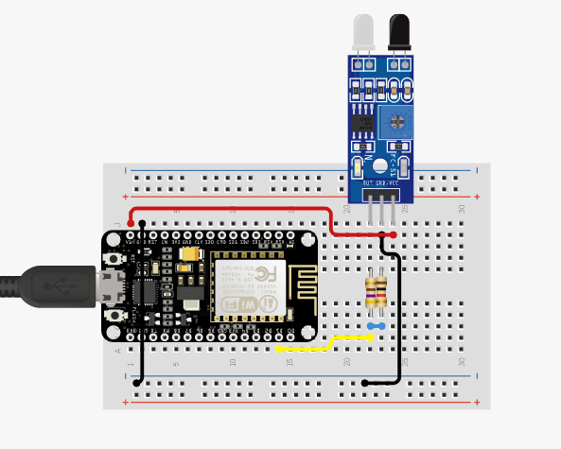
Hardware working:
NodeMCU (ESP8266 12E). ESP8266 is a microcontroller designed for Expressive Systems. ESP8266 is a solution for Wi-Fi networks from existing Micro Controllers to Wi-Fi and is also capable of running standalone applications. Connection with PC using the micro USB cable and there are 17 GPOI, with a consumed current of 10uA ~ 170mA and RAM of 32K + 80K . It is designed for wireless location-aware devices, wireless positioning system signals, industrial wireless control, etc. ESP8266 is used to process and transfer information to the web server so that the smartphone can access the information. IR obstacle sensors. It detected object range of 10-30 cm. This sensor can be used for most indoor applications where no important ambient light is present . The IR sensor will used to sense the road
traffic congestion.

Slide 18
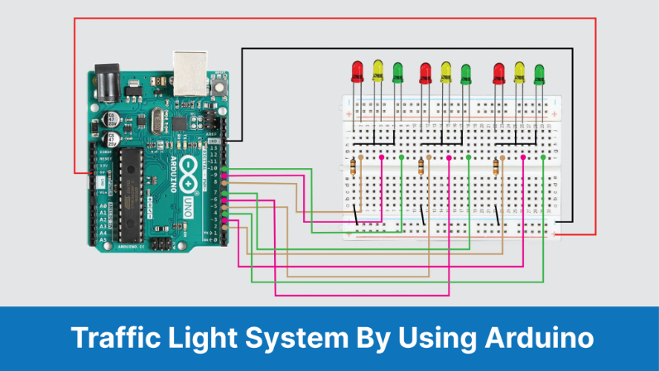
Circuit Diagram:
This is the circuit diagram for the traffic light controller by using Arduino. Connect LEDs on the breadboard as Red, Yellow, Green, respectively. Connect the negative terminal of the LED and connect the 220 Ohm resistor in series. Connect these negative terminals to the ground.

Slide 19
Software requirements:
Arduino IDE
Embedded C

Slide 20
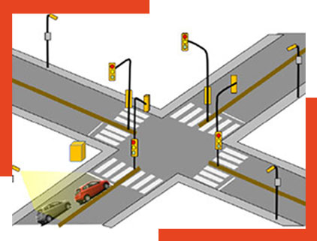
Applications:
It helps regional and municipal transportation departments to cope with the situation
It is used for helping the drivers and pedistrains will cross the crosswalk
To slove the current problems of traffic lights

Slide 21
Reference:
N. Kham, and C Nwe, “Implementation of modern traffic light control system”, International journal of scientific and research publications, Vol. 4, Issue 6, Jun. 2014.
I. Isa, N.Shaari, A.Fayeez, and N. Azlin, "Portable wireless traffic light system (PWTLS)", International journal of research in engineering and technology, Vol. 3, Issue 2, pp. 242-247, Feb 2014.
P. Sinhmar, "Intelligent traffic light and density control using IR sensors and microcontroller", International journal of advanced technology & engineering research (IJATER), Vol. 2, Issue 2, pp. 30- 35, March 2012.
E. Geetha, V. Viswanadha, and G. Kavitha, "Design of intelligent auto traffic signal controller with emergency override", International journal of engineering science and innovative technology (IJESIT), Vol. 3 , Issue 4, pp. 670-675, July 2014.
G. Kavya, and B. Saranya, "Density based intelligent traffic signal system using PIC microcontroller", International journal of research in applied science & engineering technology (IJRASET), Vol. 3, Issue 1, pp. 205-209, Jan 2015.

Slide 22
THANK YOU

